Slide 1
Face Recognition
Team 2
Sanidhya, Sahil, Tanishk, Soumyadeep

Slide 2
Dataset
A dataset is a collection of data curated for a machine learning project. An image dataset includes digital images curated for training, testing and evaluating the performance of machine learning and artificial intelligence (AI) algorithms, commonly computer vision algorithms.
Q.What is need of Dataset?
Deep Learning models are data-hungry and require a lot of data to create the best model or a system with high fidelity.Also high-quality training dataset enhances the accuracy and speed of decision-making of the model

Slide 3
Data Augmentation
Data augmentation in data analysis are techniques used to increase the amount of data by adding slightly modified copies of already existing data or newly created synthetic data from existing data.
It acts as a regularizer and helps reduce overfitting when training a machine learning model.

Slide 4
Types of Data Augmentation
Padding
Random Rotation
Rescaling
Vertical Horizontal flipping
Translation ( image is moved along X, Y direction)
Cropping
Darkening & brightening/color modification
And much more…

Slide 5
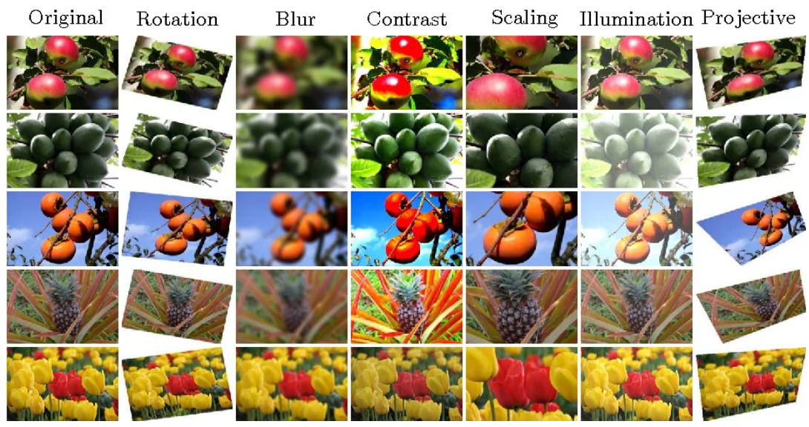
Various Types

Slide 6
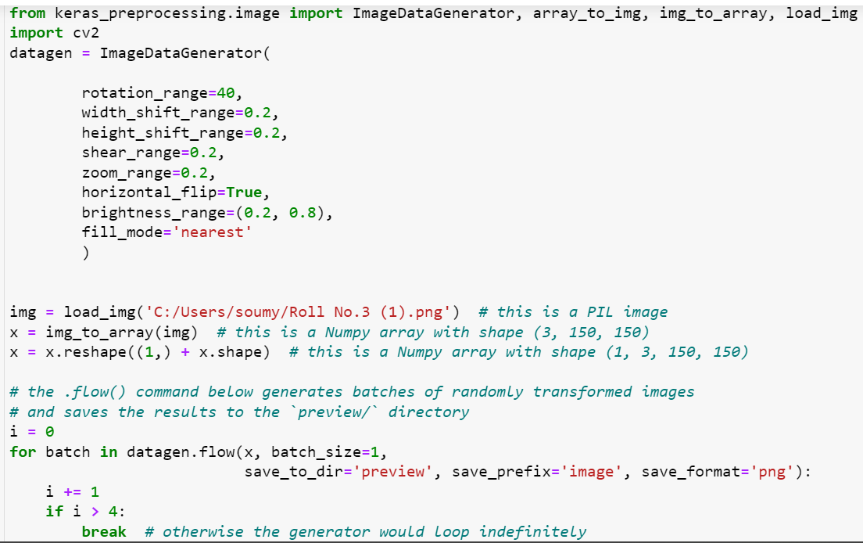
Implementation

Slide 7
Image Pair Generation
An image can be paired up with another image of the same label making a positive pair, or with another image of a different label making a negative pair.These pairs are needed for testing the Siamese Network.

Slide 8
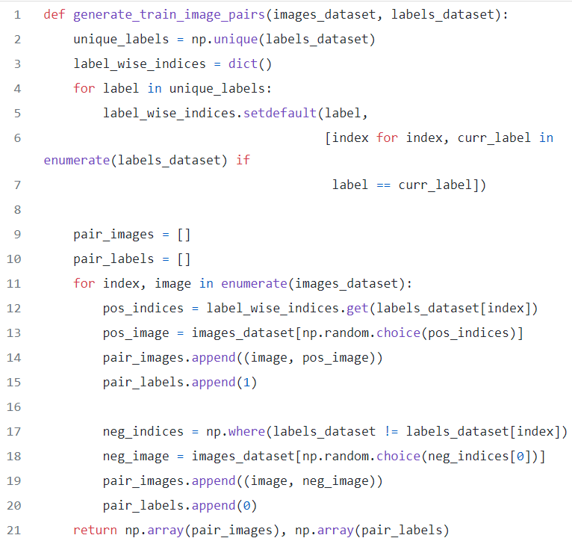
Implementation in Code

Slide 9
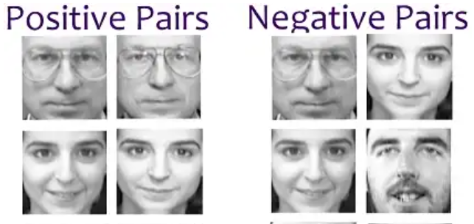
Image Pairs

Slide 10
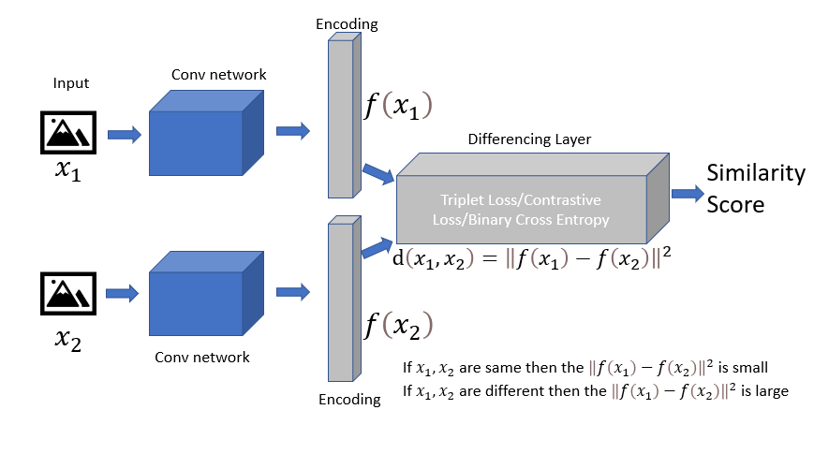
Siamese Network : Black Box view

Slide 11
Convolution Layer
‣Convolutional neural networks (ConvNets or CNNs) are more often utilized for classification and computer vision tasks
‣Convolutional neural networks are distinguished from other neural networks by their superior performance with image, speech, or audio signal inputs. They have three main types of layers, which are:
Convolutional layer
Pooling layer
Fully-connected (FC) layer
‣With each layer, the CNN increases in its complexity, identifying greater portions of the image

Slide 12
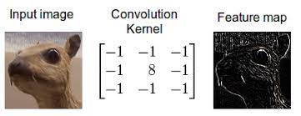
Convolution of Images
‣Convolution of an images is used to detect edges of the input image
‣Multiple convolution filters are used to get the entire outline of the image.
‣Some filters maybe responsible for vertical edges, some for horizontal edges and hence others layers for finding other type of boundaries( ex: circle, square etc.)

Slide 13
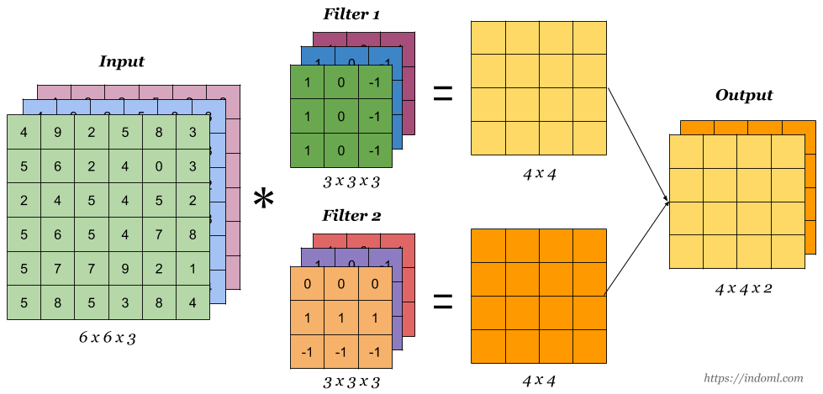
Convolution of Images

Slide 14
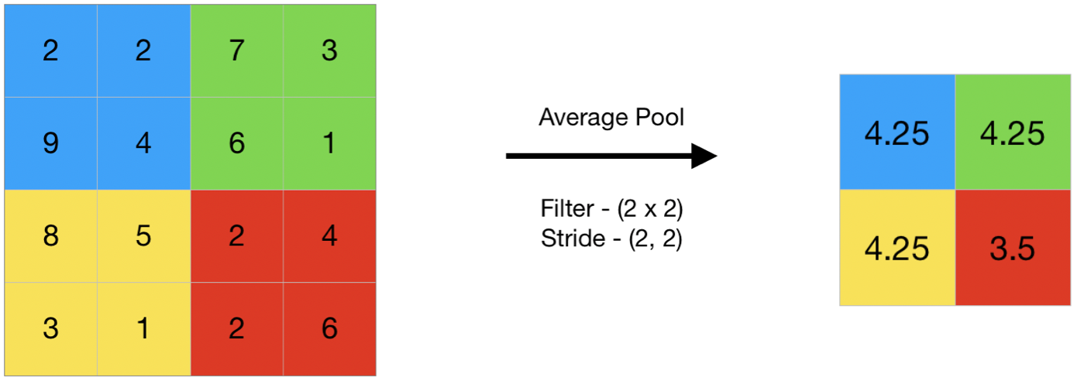
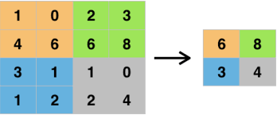
Pooling layers
Pooling layers are generally used to reduce the size of the image and also to enhance the edges.
Two types of Pooling:
MaxPooling
AveragePooling

Slide 15
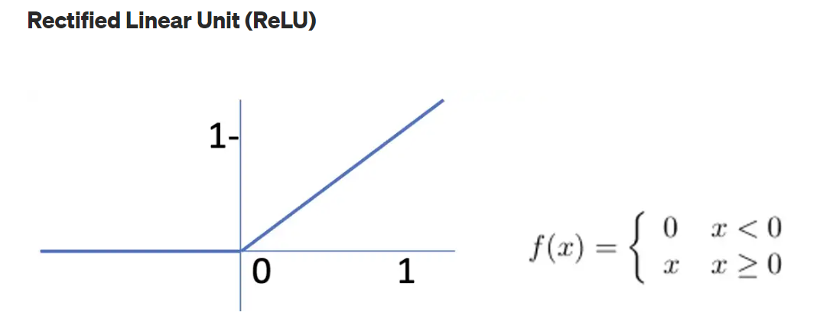
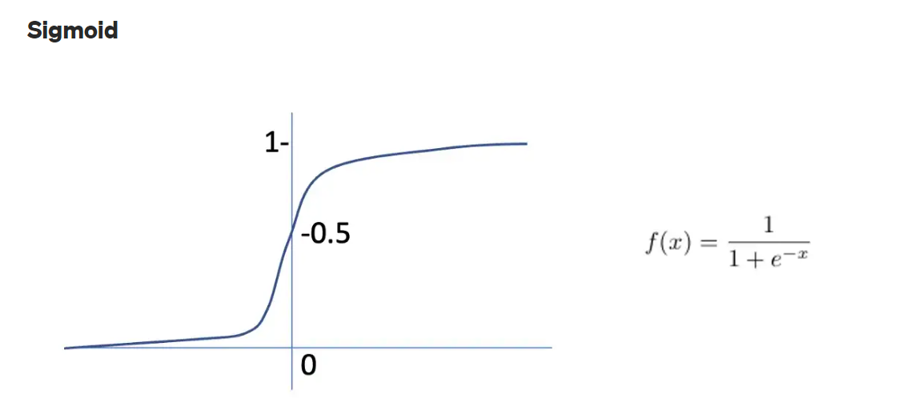
Activation functions
Activation function like Relu, sigmoid are used on the data.

Slide 16
Activation function
‣Relu layer is generally used between the intermediate layers
‣Sigmoid function is used to diminish the number in range (0,1] and hence it is used to determine the output( probability of similarity) at the output layer
Q : Why choose these functions only?
‣ReLU is important because it does not saturate; the gradient is always high (equal to 1) if the neuron activates, successive updates are fairly effective. ReLU is also very quick to evaluate.
‣Sigmoid function is good for probabilistic determination

Slide 17
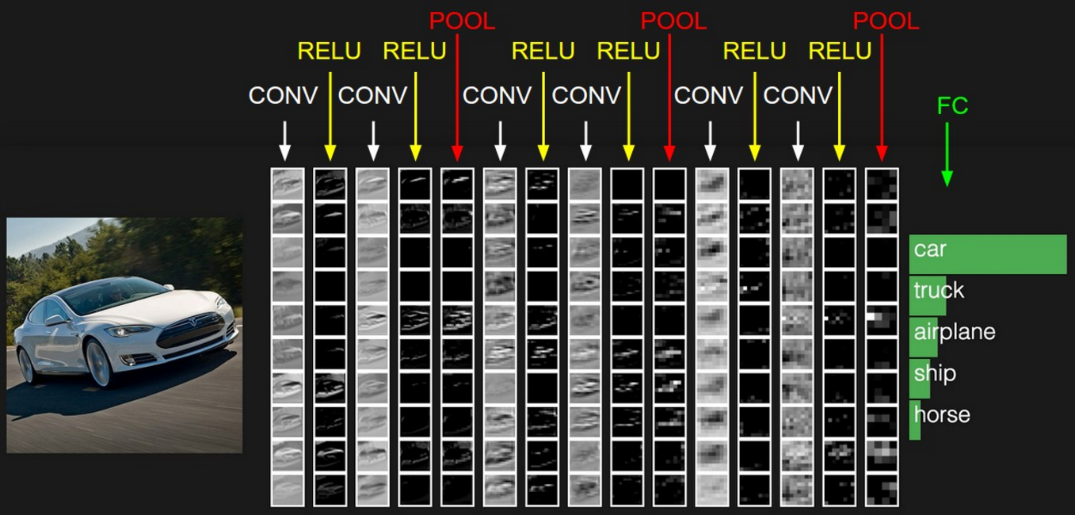
Use of Convolution and Pooling layers on Image

Slide 18
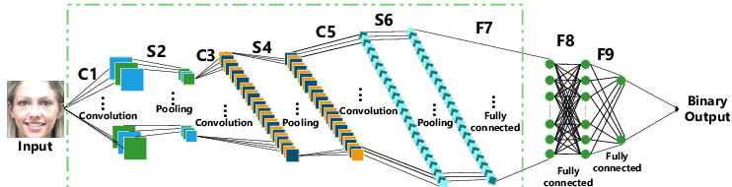
Basic Structure
Feature Learning

Slide 19
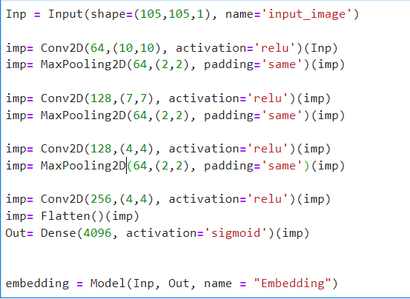
Implementation in code

Slide 20
Dense Layer
‣The flatten layer are now given by the Dense layer
‣Dense Layer : Assign weighted sum of each feature and bias
‣Ex: With 9216 features and 4096 nodes in the fully connected network ,we have 4096 nodes each having different weighted sums and biases of all the features . In the Dense layer we used Sigmoid function so that the number can be brought to a more suitable range of (0,1]

Slide 21
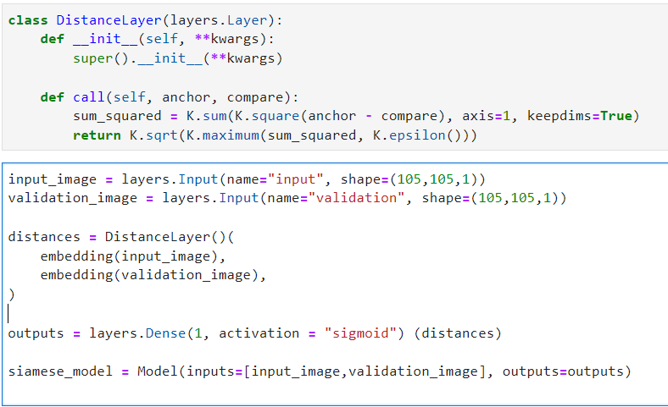
Finding distance matrix
‣After finding the distance vector we use Dense function and get weighted sum of the error term.

Slide 22
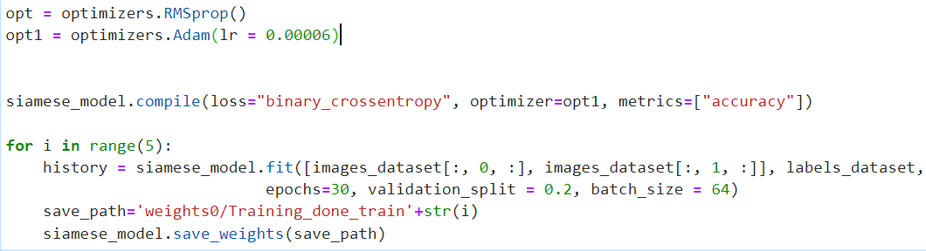
Training the model
cc
‣Now, we compile the model we created and apply gradient descent ( which the fit function is doing)
Q: Gradient Descent?
‣It is adjusted the weights so as to get the best fit for the input image using derivative principles, This is also called as backpropagation.
‣At the end we get the appropriate weights for our model…and hence the training is complete

Slide 23
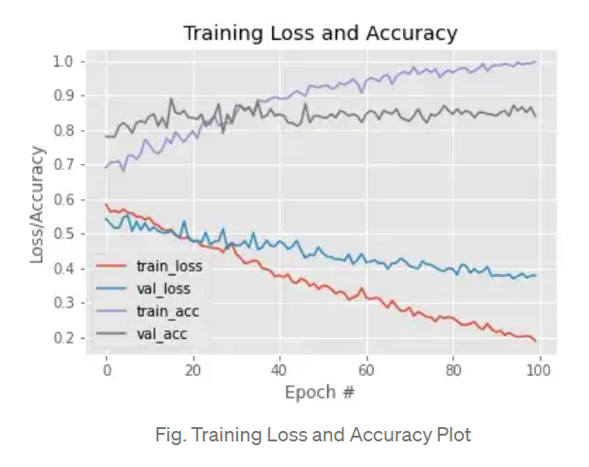
Some observational graphs

Slide 24
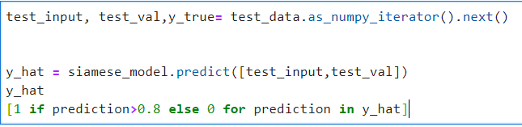
Testing
‣We use predict function use “predict” the output of comparing a test and validation image..
‣At the end, we define a threshold above which we can consider the output to be similar( or 1)

Slide 25


